Slide 1

The Project Manager

Slide 2
Chapter Concepts
The responsibilities of the project manager
The skills needed to successfully manage projects and ways to develop project manager competence
Approaches to effective delegation
How the project manager can manage and control changes to the project

Slide 3
Learning Outcomes
Discuss three responsibilities of a project manager
Identify, explain, and practice at least five skills and abilities a project manager should have
Explain how one would develop competence as a project manager
Describe how one can effectively use delegation
Explain how to manage changes

Slide 4
Project Integration Management Project Human Resource Management Project Stakeholder Management
Project Management Knowledge Areas from PMBOK® Guide

Slide 5
Project Manager Responsibilities
Customer satisfaction
Work scope completion
Quality manner, within budget, on time
Planning the project
Securing and organising the appropriate resources
Controlling the project progress
Coordinate with team
Control the project

Slide 6
Planning
Define project objective
Reach agreement with customer
Communicate objective to project team
Create vision of successful achievement
Spearhead plan development
Review plan with customer
Use project management information system

Slide 7
Organising
Secure appropriate resources
Determine in-house tasks
Determine need for subcontractor
Assign responsibility
Delegate authority
Create motivating environment

Slide 8
Controlling
Track actual progress
Compare progress to planned progress
Take necessary actions
Play the leadership role
Involve project team

Slide 9
Project Manager Skills: Leadership ability
Achieve results through the project team
Use a participative and consultative leadership style
Provide guidance and coaching to the project team
Require involvement and empowerment of the project team
Establish an environment of trust, high expectations, and enjoyment
Have self confidence
Exhibit confidence in the project team

Slide 10
Ability to develop people
Train and develop the project team
Believe that all individuals are valuable
Encourage initiative
Identify situations for mentoring
Assess opportunities for growth
Encourage self reflection for learning

Slide 11
Communication skills
Be good communicators
Communicate and share information
Spend more time listening than talking
Inform the customer of progress
Determine any changes
Provide timely feedback to the team and customer

Slide 12
Interpersonal skills
Develop a relationship with each team member
Maintain interpersonal relationships for duration of the project
Influence the thinking and actions of others
Deal with disagreements or divisiveness

Slide 13
Ability to handle stress
Must be able to handle the stress
Remain calm
Cope with constantly changing conditions
Act as a buffer between the project team and either the customer or upper management
Have a good sense of humour
Keep physically fit to improve ability to handle stress

Slide 14
Problem-solving skills
Be a good problem solver
Start with the early identification of a problem or potential problem
Encourage project team members to identify problems early and solve them

Slide 15
Negotiating skills
Employ negotiating skills in interactions
Develop a trusting relationship with the other person
Use effective listening
Take cultural differences into consideration
Strengthen relationships, not erode them

Slide 16
Time management skills
Manage time well
Have self-discipline
Be able to prioritise
Show a willingness to delegate

Slide 17
Delegation
Delegating
Barriers to delegating
Empower the project team
Use effective communication skills
Select the most qualified project team members
Can do it better or faster yourself
Lack confidence in the capability of others
Afraid will lose control
Fear criticism for mistakes
Lack self-confidence

Slide 18
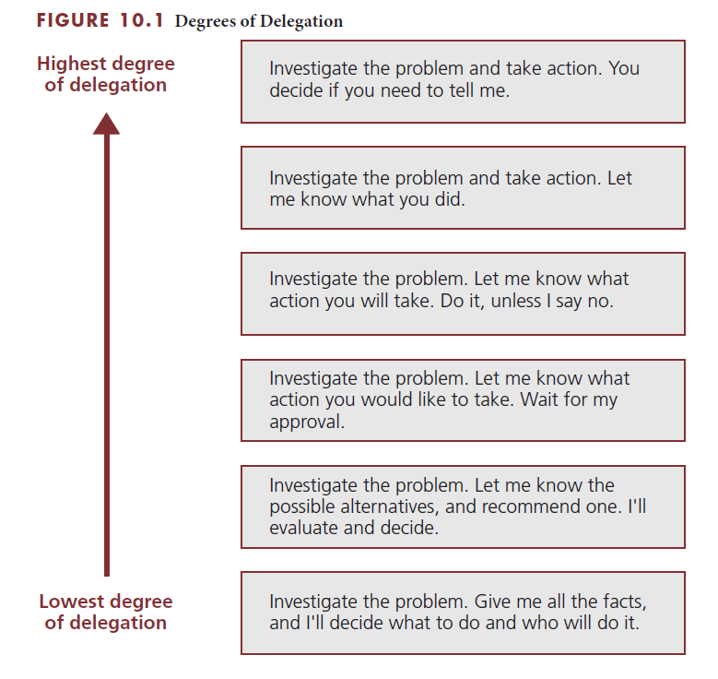
Various degrees of delegation

Slide 19
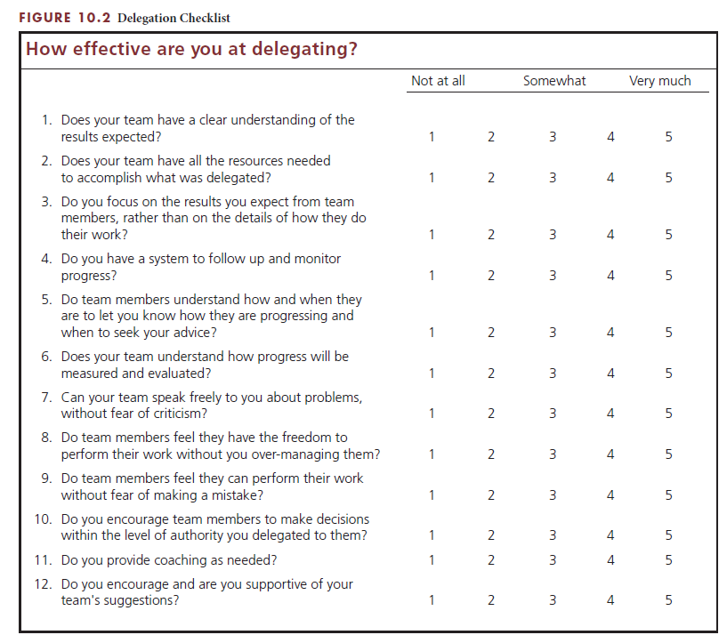
Checklist for rating delegation effectiveness

Slide 20
Managing Changes
Initiation of change
Manage and control change
By the customer
By the project team
Caused by unanticipated occurrences
Required by the users of the project results
Establish procedures for communication
Estimate impact of change
Decide about the change
Customer approves change

Slide 21
Critical Success Factors
Successful project managers accept responsibility for making sure the customer is satisfied and the work scope is completed in a quality manner, within budget, and on time.
The project manager needs to be proactive in planning, communicating, and providing leadership to the project team to achieve the project objective.
The project manager needs to inspire the project team to succeed and to win the confidence of the customer.
By involving the project team in developing the project plan, the project manager ensures a more comprehensive plan and gains the commitment of the team to achieve the plan.
Successful project managers are proactive in addressing problems. They do not take a 'let’s wait and see how things work out' approach.
The project manager needs to have a project management information system that distinguishes achievements from busy-work.
Effective project managers have strong leadership ability, the ability to develop people, excellent communication skills, good interpersonal skills, the ability to handle stress, problem-solving skills, negotiating skills, and time management skills.

Slide 22
Critical Success Factors (continued)
Successful project management requires a participative and consultative leadership style in which the project manager provides guidance and coaching to the project team. The effective project manager does not tell people how to do their jobs.
Project managers show they value the contributions of team members when they seek advice and suggestions from team members.
Project managers can foster motivation through recognition. People want to feel they are making a contribution and need to be recognised. Positive reinforcement helps stimulate desired behaviour; behaviour that is recognised or rewarded gets repeated.
The effective project manager does not monopolise, seek the spotlight, or try to take credit for the work of others.
Capable project managers are optimistic and have high, yet realistic, expectations of themselves and each person on the project team.
Projects should be fun. Project managers should enjoy their work and encourage the same positive attitude on the part of the project team members. The project manager should set a positive example for the team in terms of expected behaviour.
A good project manager provides opportunities for learning and development by encouraging team members to take the initiative, take risks, and make decisions. Rather than create a fear of failure, the project manager realises that mistakes are part of the learning and growth experience.

Slide 23
Critical Success Factors (continued)
Good project managers spend more time listening than talking. They listen to the needs expressed by the customer and the ideas and concerns expressed by the project team and stakeholders.
Communication by project managers needs to be timely, honest, and unambiguous.
The project manager should create an atmosphere that fosters timely and open communication without fear of reprisal, and must be open to differing viewpoints.
When unforeseen events cause turmoil on a project, effective project managers remain composed and do not panic.
Effective project managers recognise that the best solution often emerges from differences of ideas, viewpoints, experiences, and opinions.
The project manager must maintain integrity and respect for the other party throughout the negotiating process.
To make effective use of their time, project managers need to have self-discipline, be able to prioritise, and be willing to delegate.
At the start of a project, the project manager needs to establish a change control system that define how changes will be documented, approved, and communicated.

Slide 24
Summary
It is the responsibility of the project manager to make sure that the customer is satisfied that the work scope is completed in a quality manner, within budget, and on time.
The project manager has primary responsibility for providing leadership in planning, organising, and controlling the work effort to achieve the project objective.
The project manager is a key ingredient in the success of a project and needs to possess a set of skills that will help the project team succeed.
Project manager competence can be developed through a number of activities, individually or with others.
Project managers need to be good delegators.
The project manger manages and controls changes to minimise any negative impact on the successful accomplishment of the project objective.

